Slide 1
Fractal Blasters Media Player

Slide 2
Product Line Characteristics
Plays audio files
Runs using Windows and .NET Framework
Plug-in Based
Keeps a media library of music stored on the user’s computer

Slide 3
Commonalities
Will be able to decode and play .wav and .raw file forms
Will be able to utilize basic media controls (play, pause, stop, back, forward, volume, position)
Accept controls from user via mouse
Output audio through variable devices
Support progressing playlist
The suite will support a built-in library feature

Slide 4
Variabilities
The suite may or may not support various file extensions (including mp3, wma).
The suite may or may not be capable of sorting music by category
The suite may or may not support saving and loading playlists.
The suite may or may not have a visualizer packaged with it.
The packaged visualizer may have a large range of available features/styles, or fewer
The suite may or may not support multiple playlists being open at the same time.

Slide 5
Fractal Blasters Architecture
Modules are divided into three categories:
File Management
User Interface
Wave Processing
Additional code will be implemented for installation, startup, and common interfaces

Slide 6
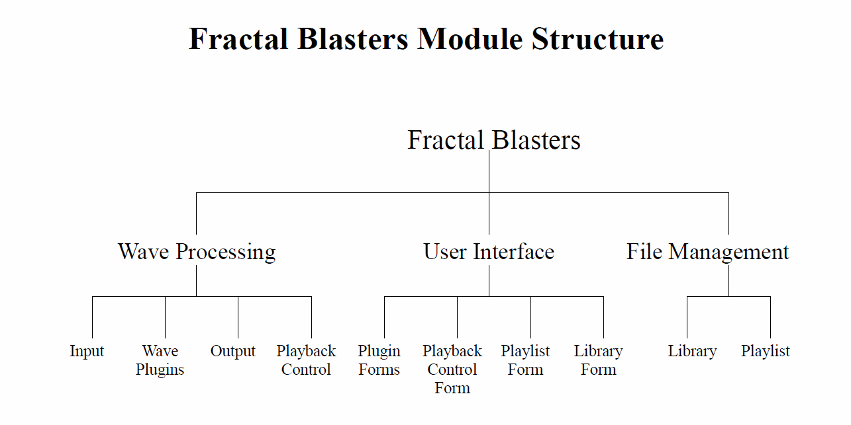

Slide 7
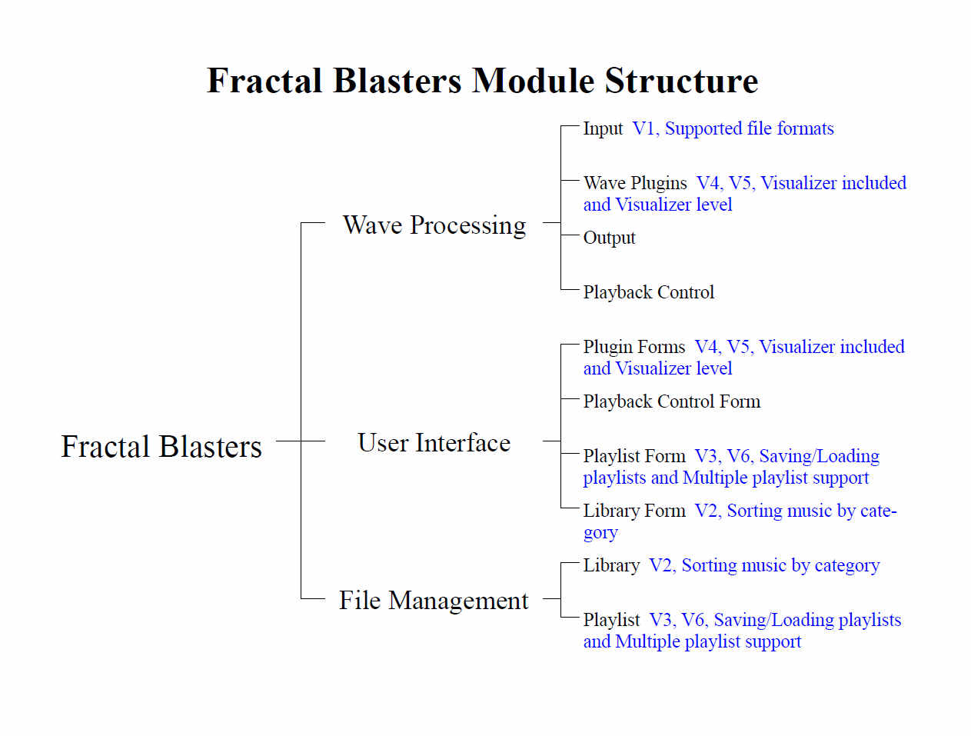

Slide 8
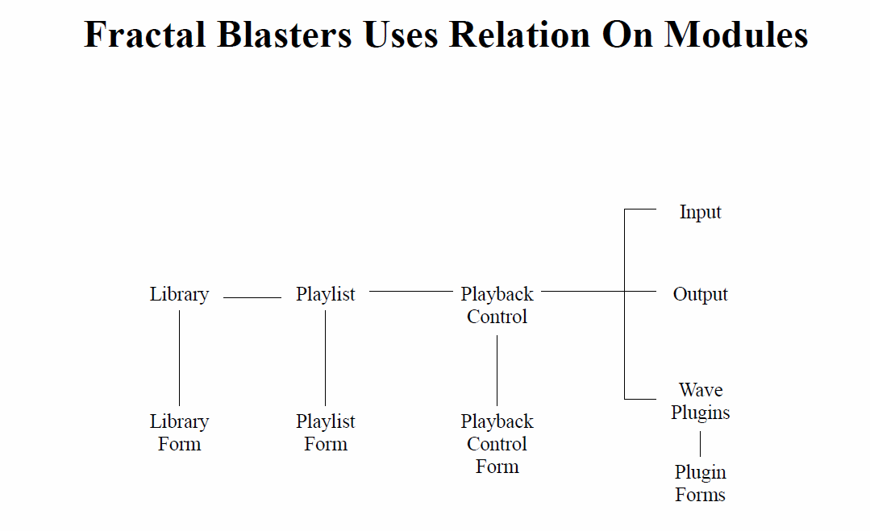

Slide 9
Development – Decoding/Output
3rd Party Library – FFMPEG
Supports all file formats
Provides PCM audio stream
Windows API
Waveform Audio Functions
Custom Audio Buffers

Slide 10
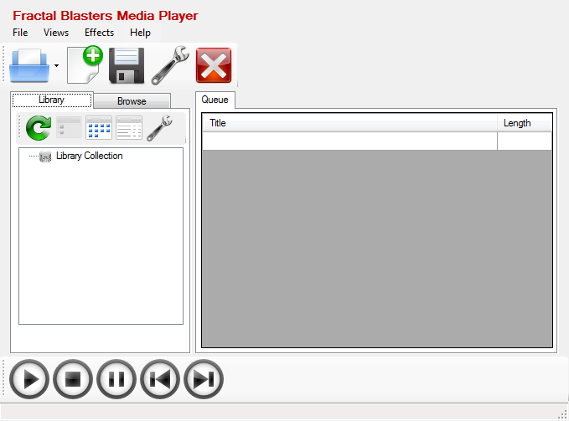
Screenshots

Slide 11
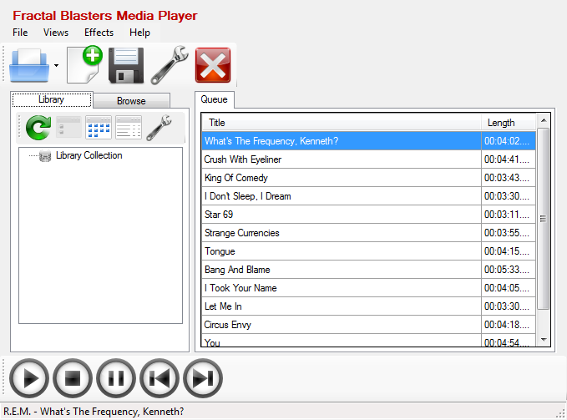
Screenshots

Slide 12
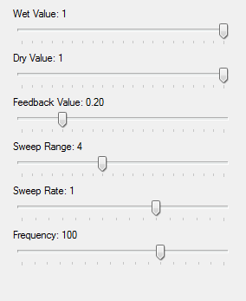
Screenshots

